Slide 1

Neural Network Model for Credit Scoring
By
Amat Alrahman Amin khalif Alshoura
Course Name: Programming in Python

Slide 2

Introduction
Credit scoring is assessing an individual's creditworthiness based on their financial history and other factors.
A credit scoring system that incorporates artificial intelligence (AI) and neural networks enables more precise and effective risk assessment.

Slide 3
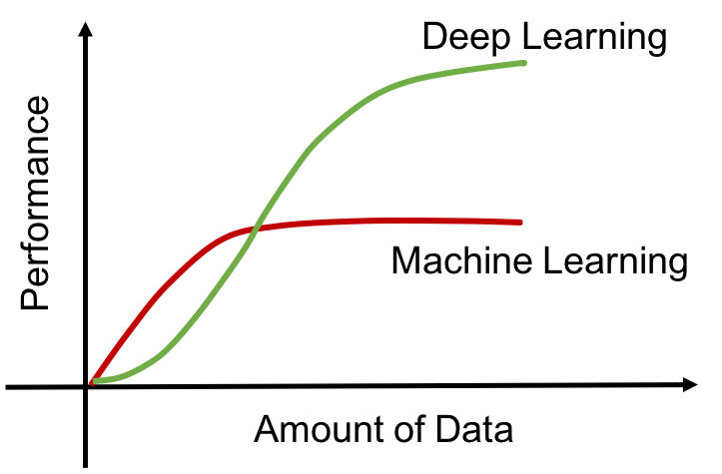
Methodology
Creating a Multilayer Perceptron (MLP) model that can precisely predict the probability of a borrower defaulting on a loan.

Slide 4
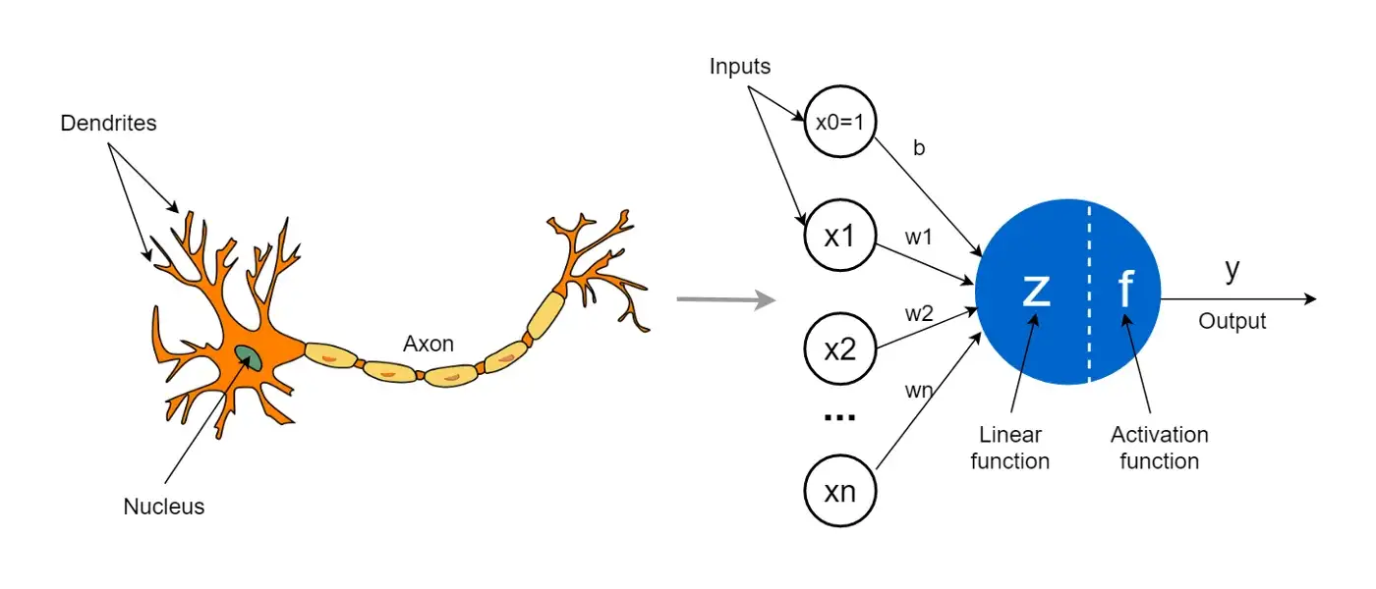
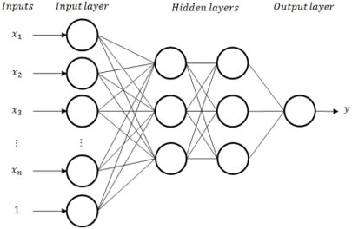
Artificial Neural Networks (ANN)
an artificial neuron is a computational model inspired by natural neurons.

Slide 5

Project objective
To make a prediction of creditworthiness by predicting if the person will experience 90 days past due delinquency or worse in the next two years using a Multilayer perceptron MLP neural network

Slide 6






Used packages
NumPy
Pandas
scikit-learn
TensorFlow
Keras
Matplotlib

Slide 7
Datset:
Dataset name: Give Me Some Credit
Link: Give Me Some Credit | Kaggle

Slide 8

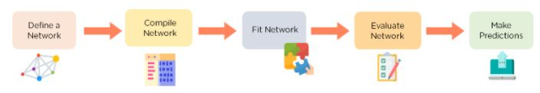
Build the model

Slide 9
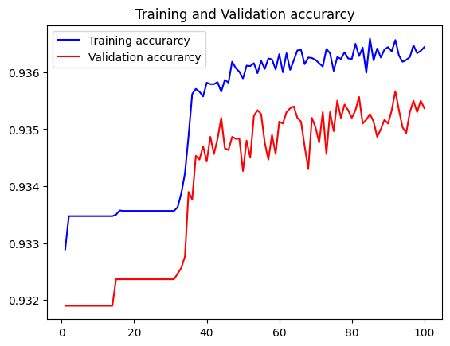
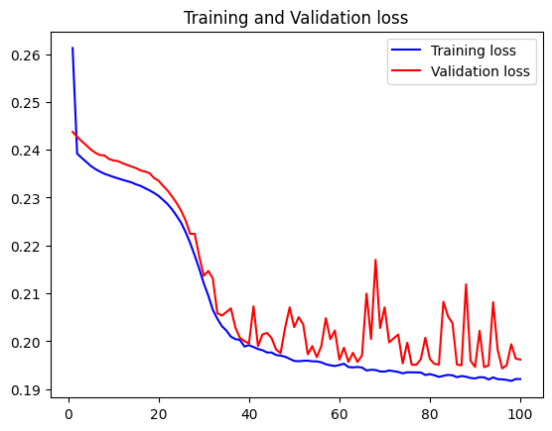
Results and analysis
The Final Accuracy= 0.935366690158844

Slide 10
Conclusions and recommendations
The neural network model is a promising solution for credit scoring, outperforming traditional machine learning models in terms of accuracy and F1 score.
the main strengths of the neural network model is its ability to handle a large amount of data and capture non-linear relationships between features.
I recommend further research to explore other architectures and techniques to improve the model's performance and generalizability to other datasets.

Slide 11
Thank you
Any Questions ?
Amat Alrhman Amin Alshoura
You can find me on :
LinkedIn: www.linkedin.com/in/amt-al-rhman
GitHub: amtalrhmnan (Amat Alrhman Amin Alshoura) (github.com)

